Slide 1
ZF Diet Inf Results

Slide 2
Questions
Diet
Does diet affect fish physiology?
Does diet affect the microbiome?
Development
Does time link to physiology?
Does time link to microbiome?
How do fish microbiomes develop over time as a function of diet and physiology?
Pathogen Exposure
Does exposure affect the microbiome?
Is the exposure effect on the microbiome diet dependent?

Slide 3
Does diet affect fish physiology?

Slide 4
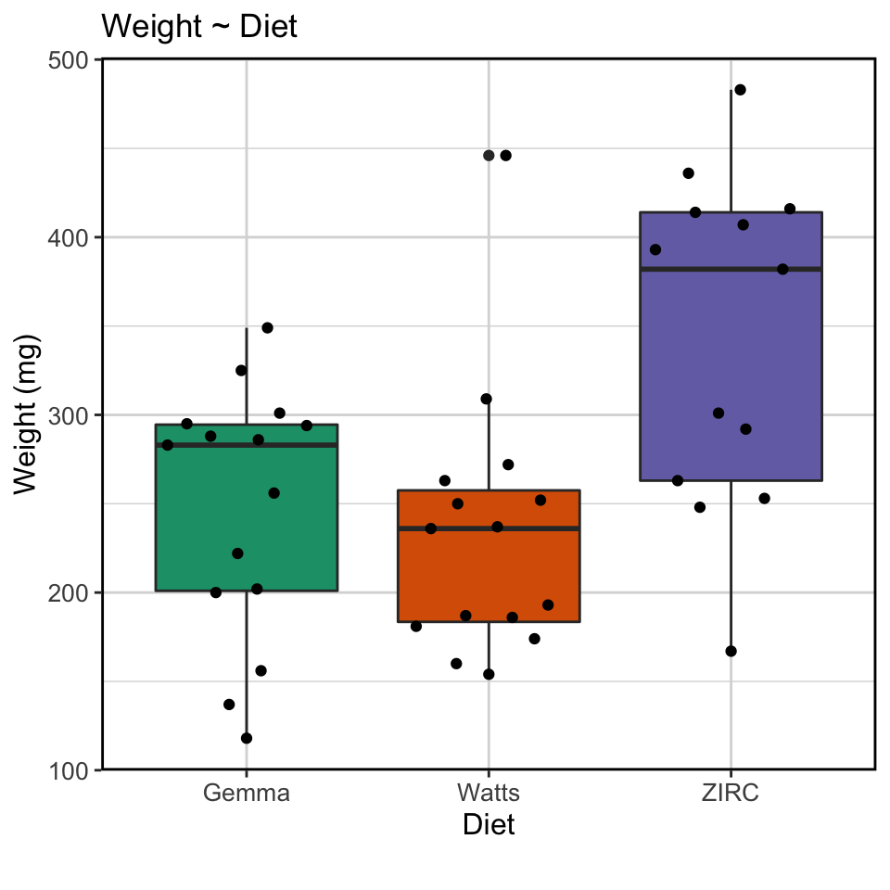
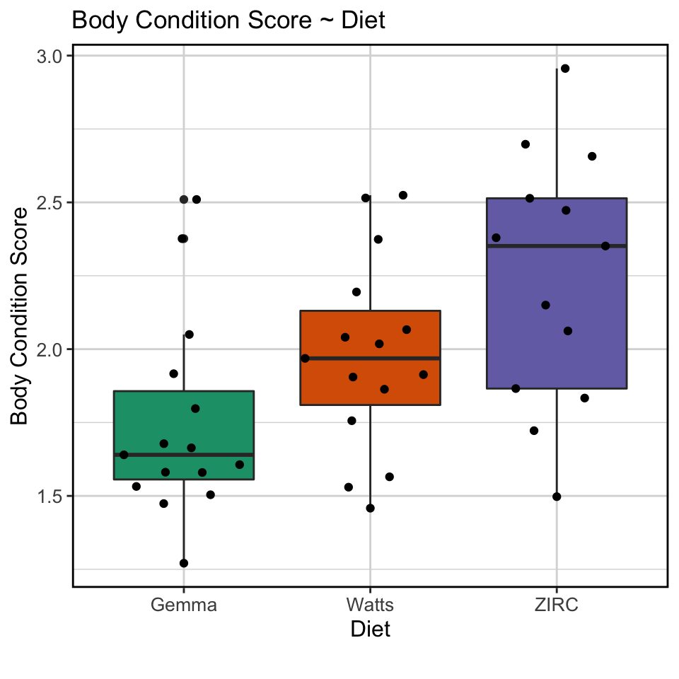
ZIRC diet had higher weight and body condition scores

Slide 5
Does diet link to fish microbiome?

Slide 6
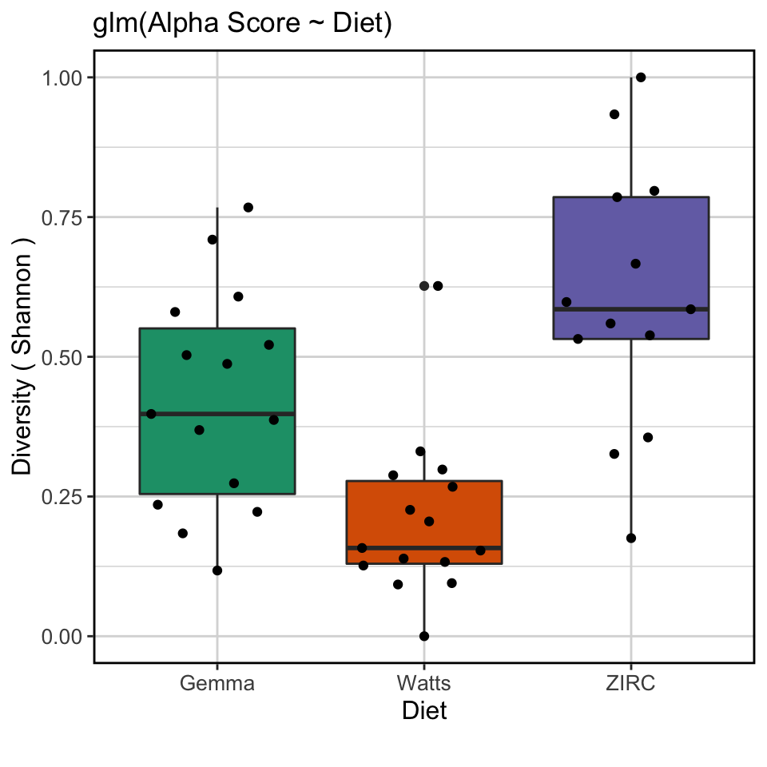
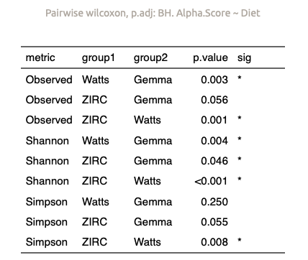
Alpha diversity score stratified by diet with ZIRC having the highest, followed by Gemma and Watts with the lowest
(final timepoint)

Slide 7
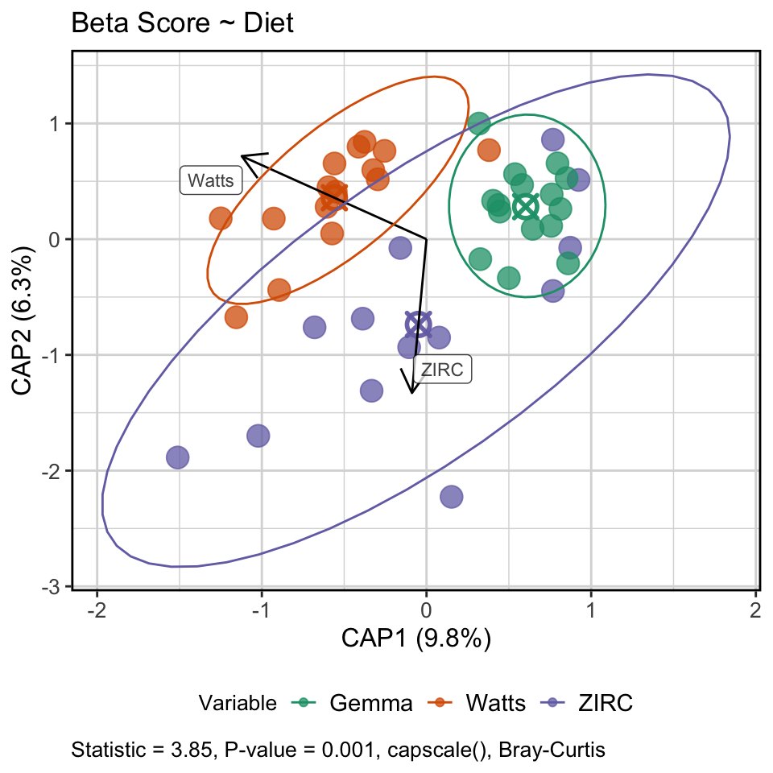
Diet stratifies the composition of the gut microbiome
(final timepoint)

Slide 8
Differentially abundant genera found across diets
(final timepoint)

Slide 9
Does time link to physiology?

Slide 10
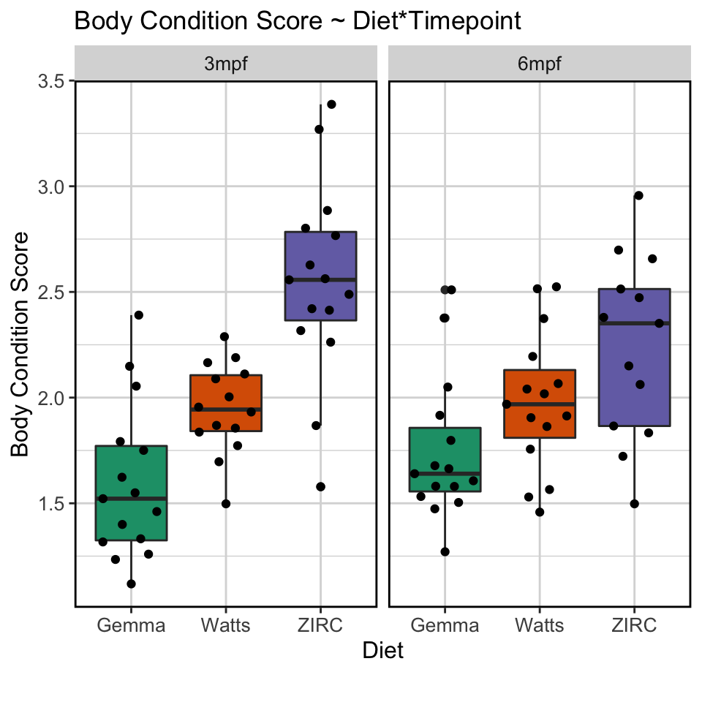
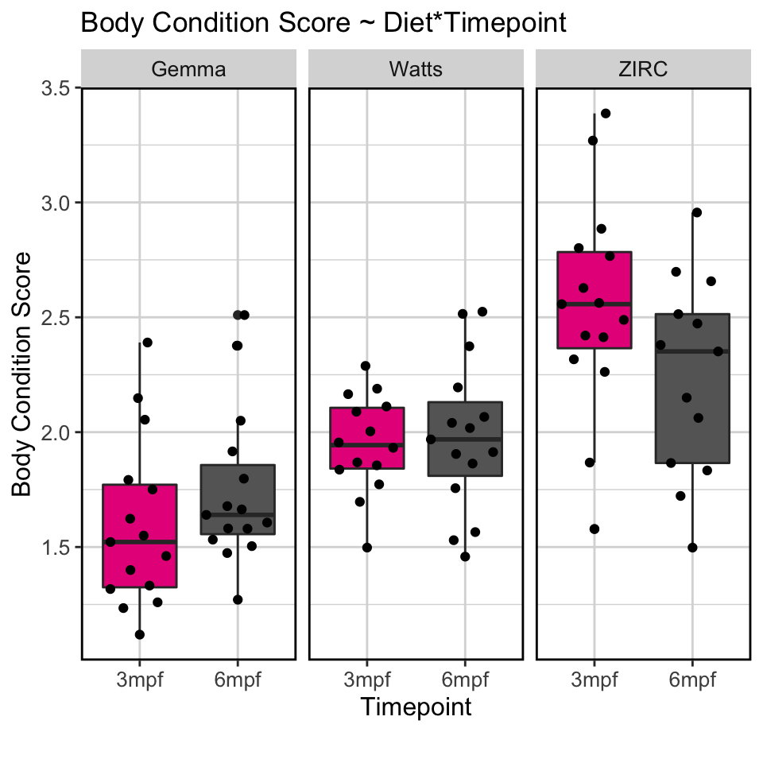
ZIRC fed fish have higher BCS across development, while other diets are more stable

Slide 11
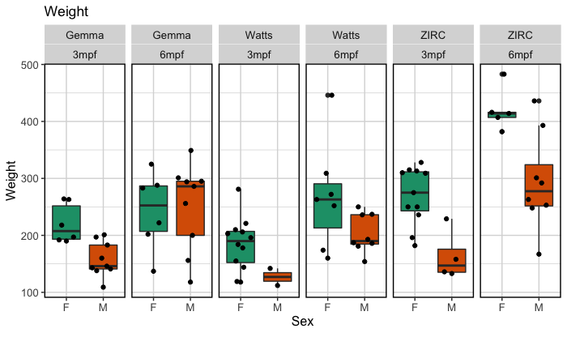
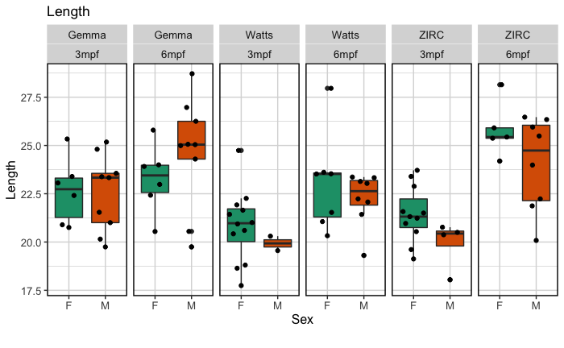
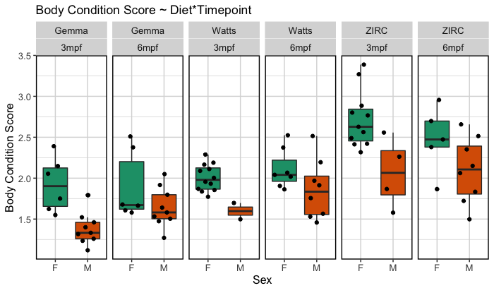
Body.Condition.Score = (Weight/(Length^3)*100)

Slide 13
Does time impact the microbiome?

Slide 14
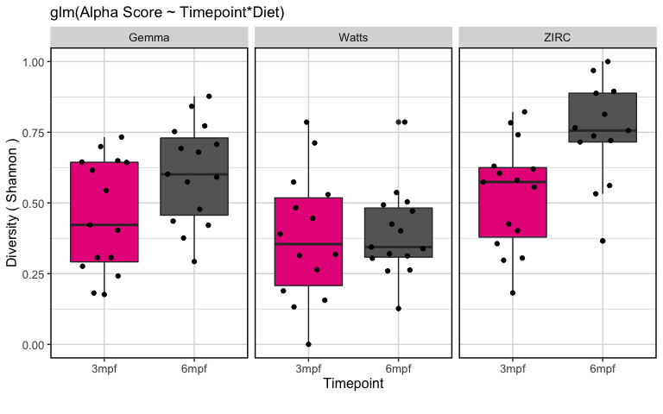
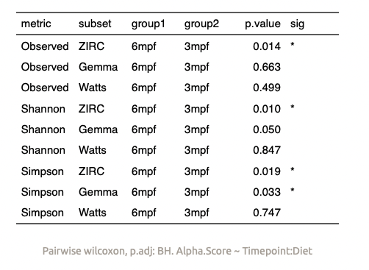
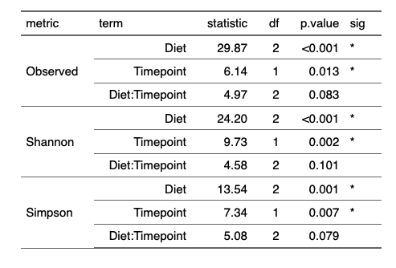
Diet and time associate with diversity, but the interaction effect is weak
Notes:
watts diet is temporally more stable. Gemma and ZIRC increase over time

Slide 15
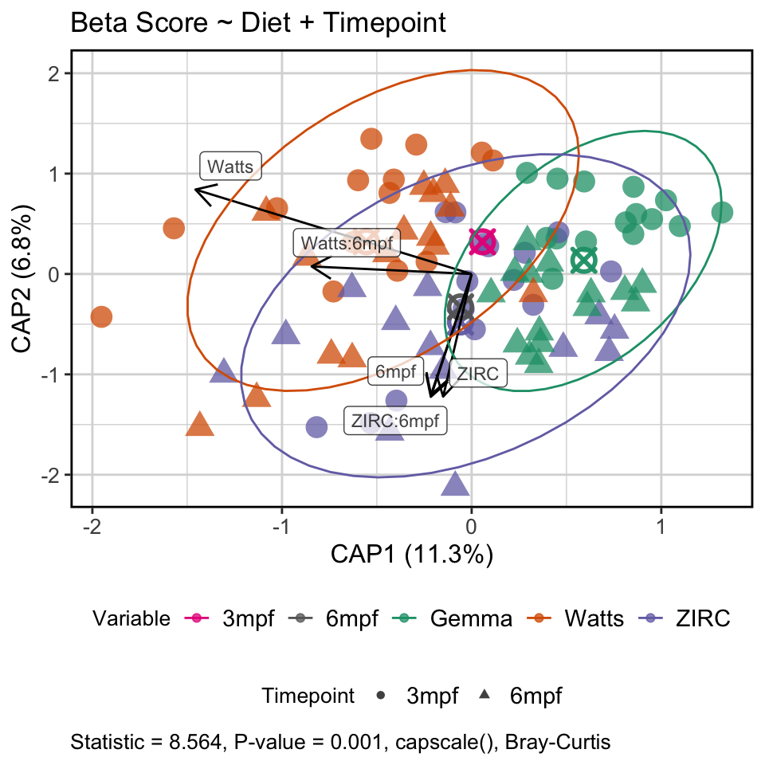
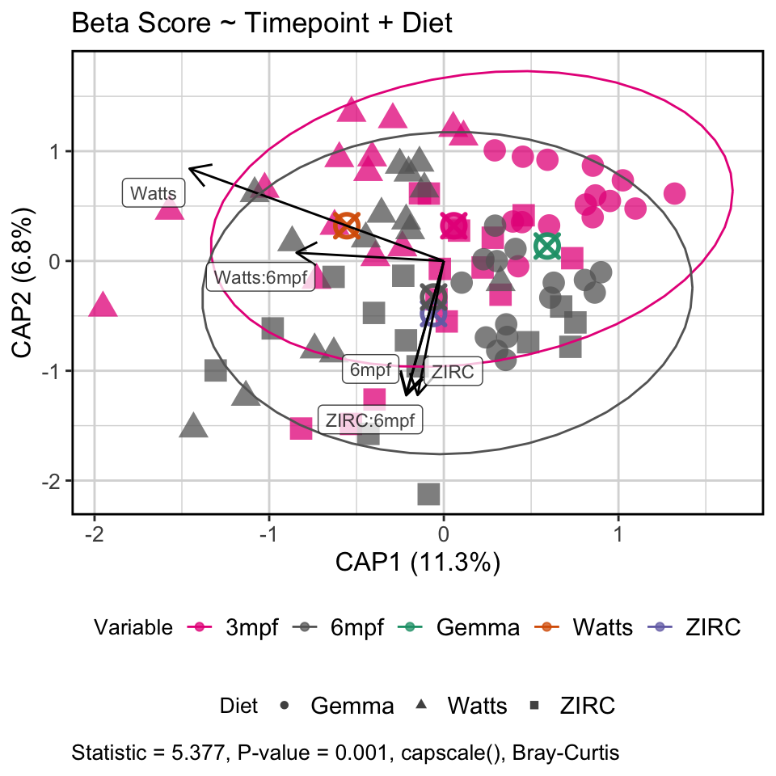
Diet driving abundance of certain taxa, while time influences composition
Notes:
Microbiome composition changes regardless of diet

Slide 16
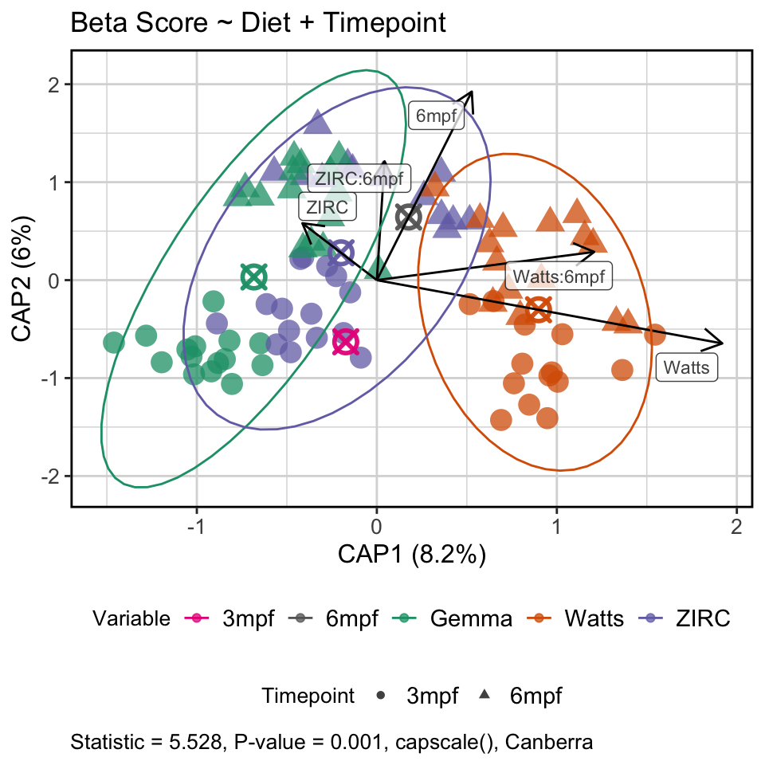
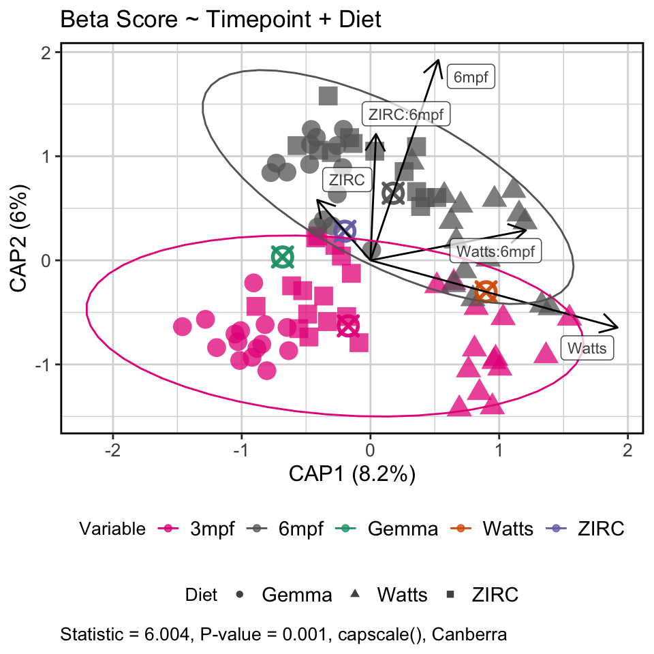
Diet driving abundance of certain taxa, while time influences composition
Notes:
Microbiome composition changes regardless of diet

Slide 19
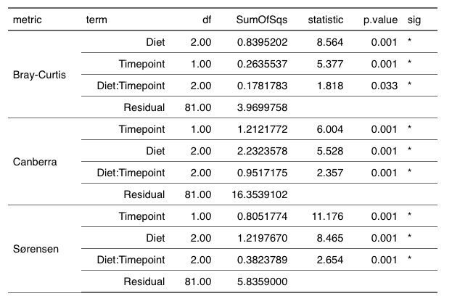

Slide 20
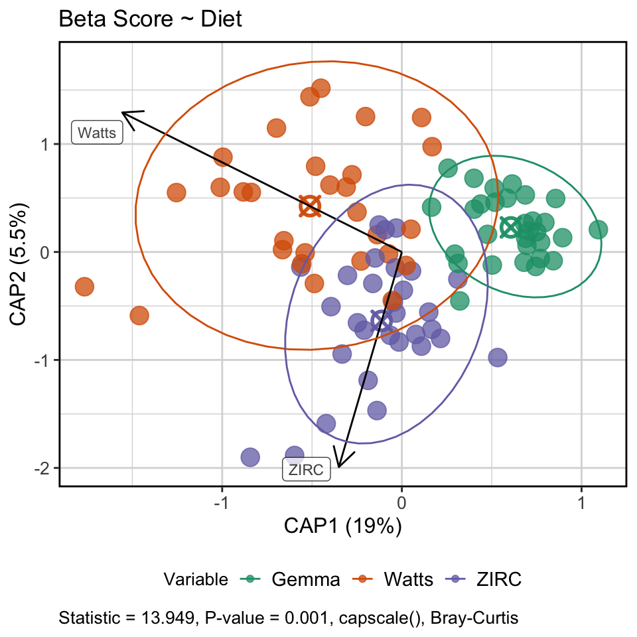
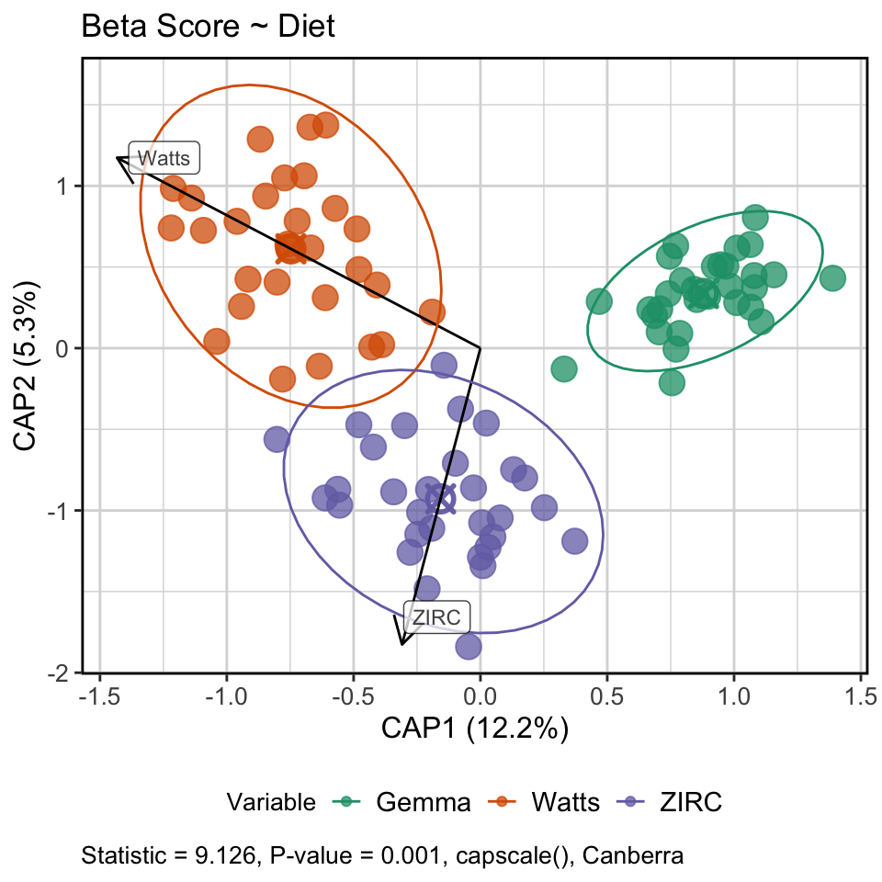
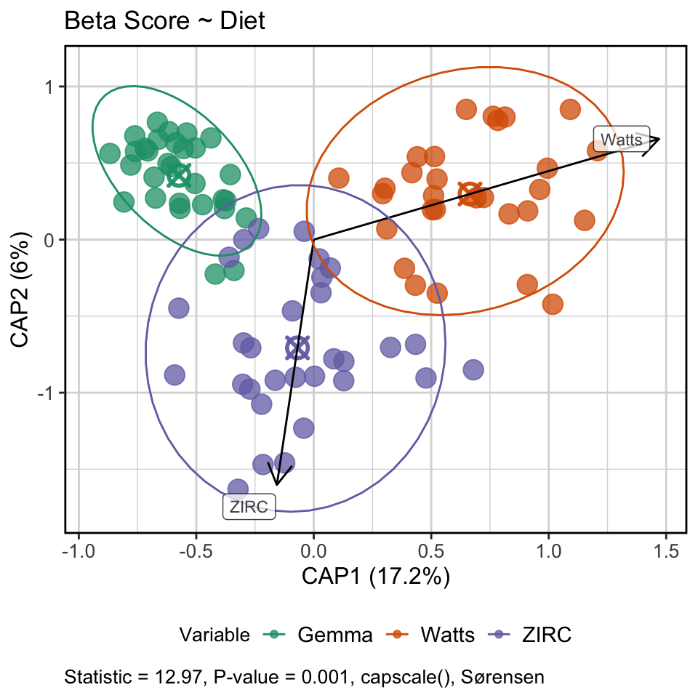
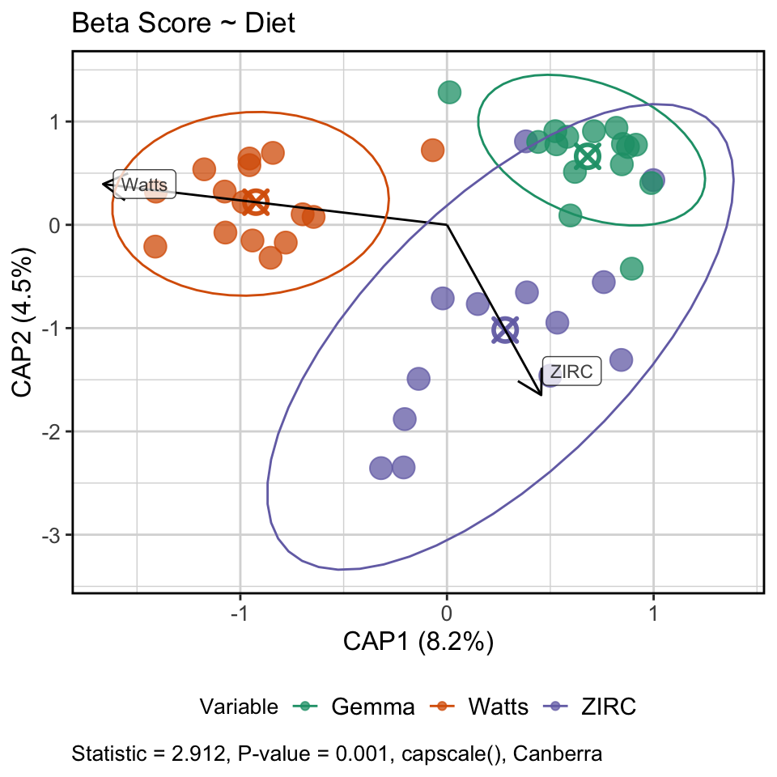
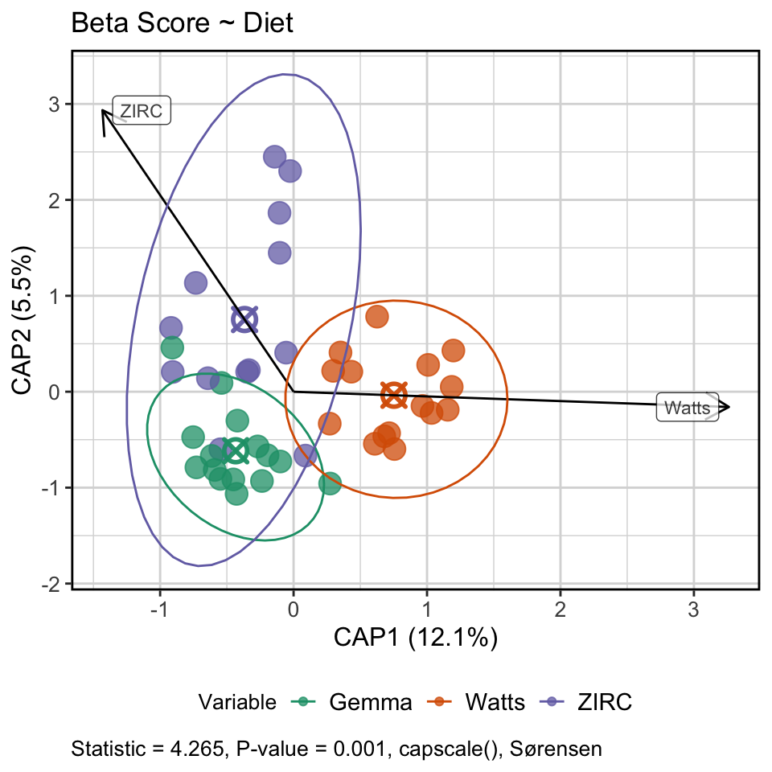
INITIAL
FINAL

Slide 21
How do fish microbiomes develop over time as a function of diet and physiology?

Slide 22
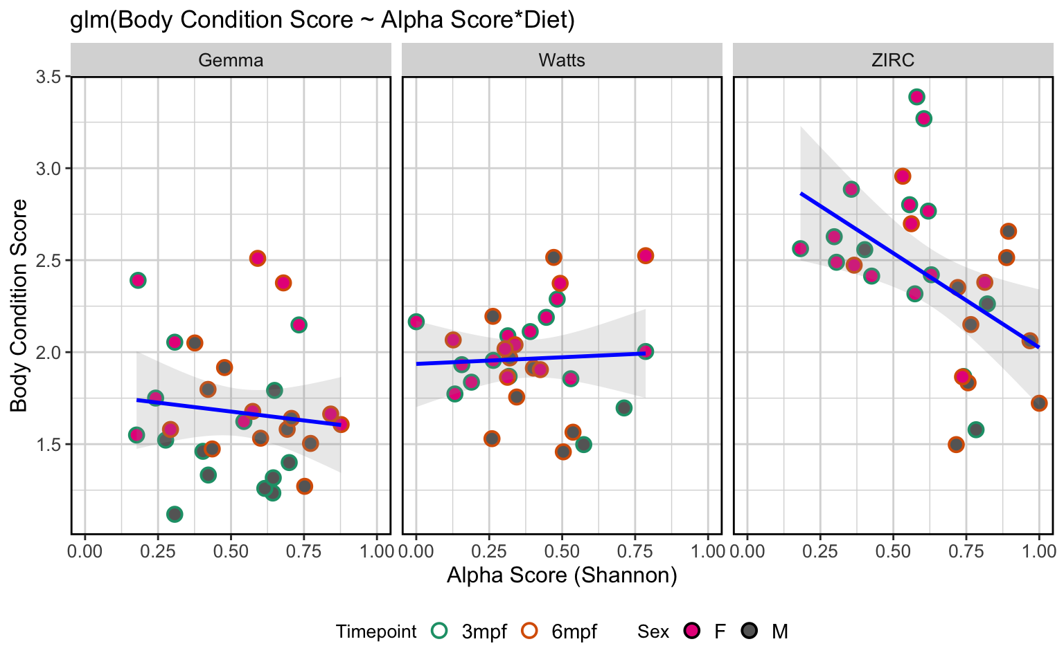
Body condition score decreases as alpha diversity increases in ZIRC fed fish

Slide 23
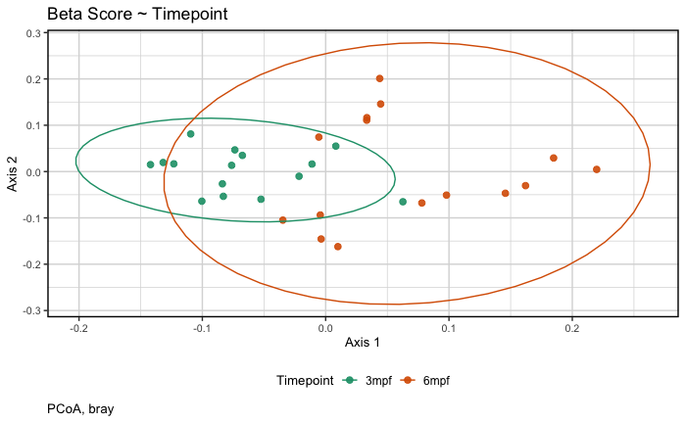
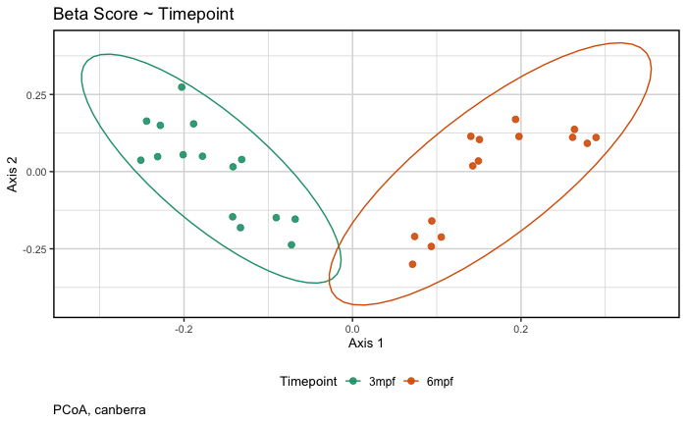
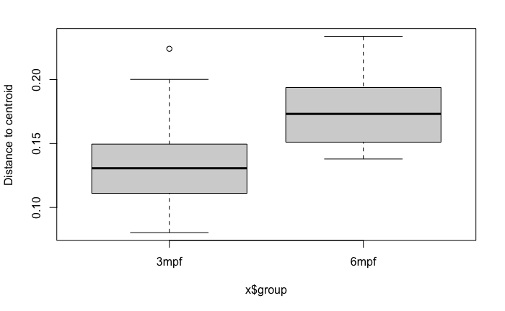
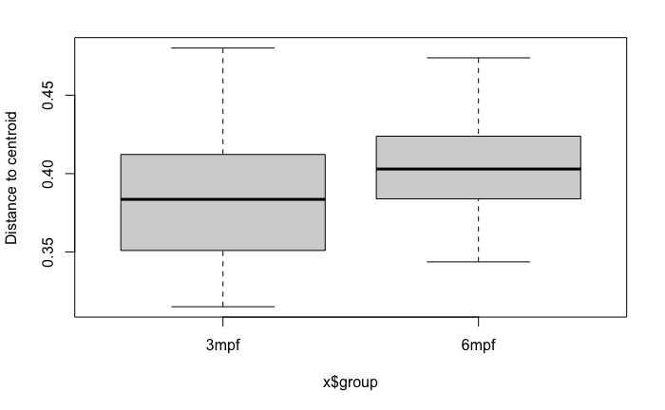
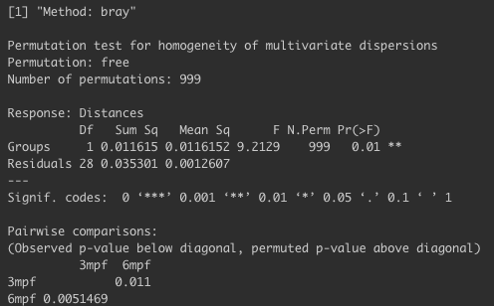
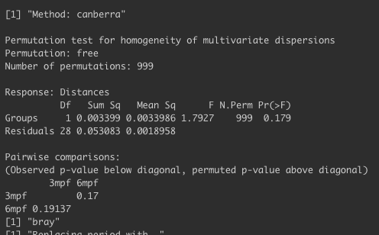

Slide 24
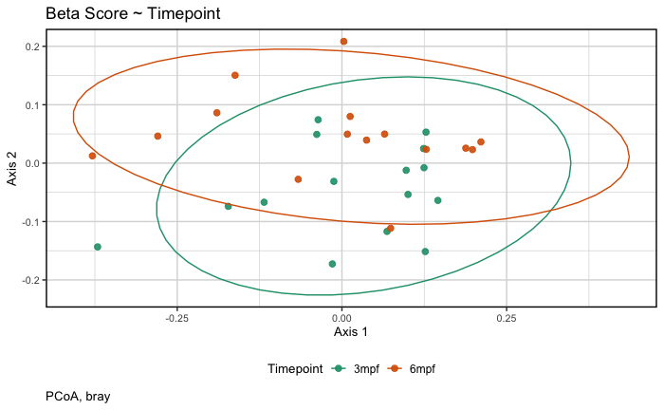
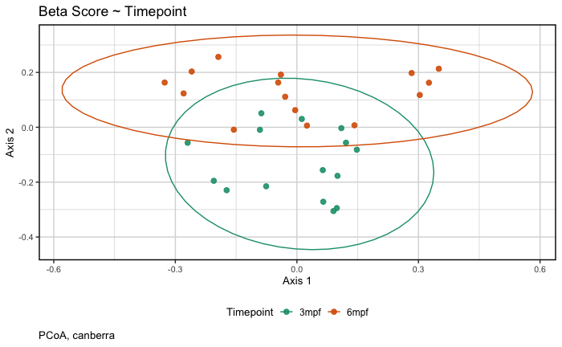
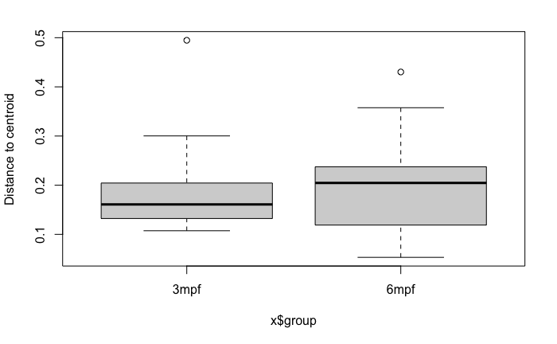
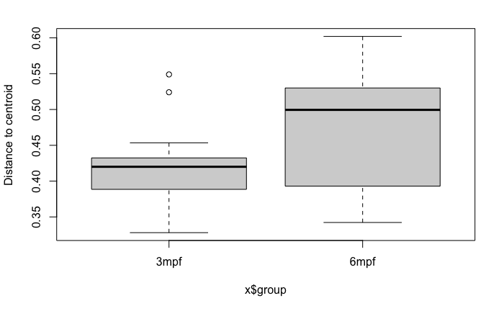
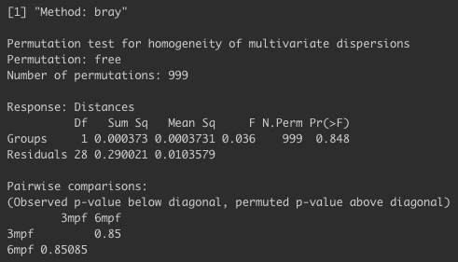
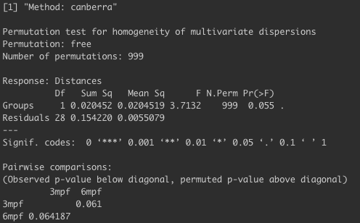

Slide 25
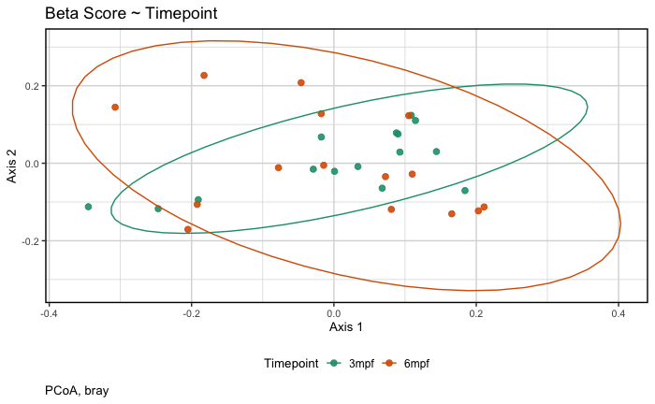
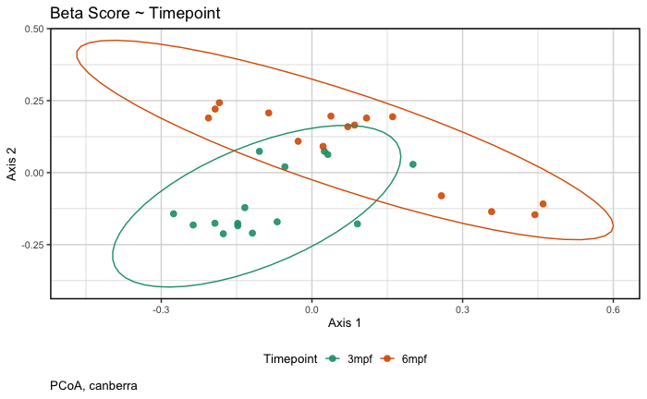
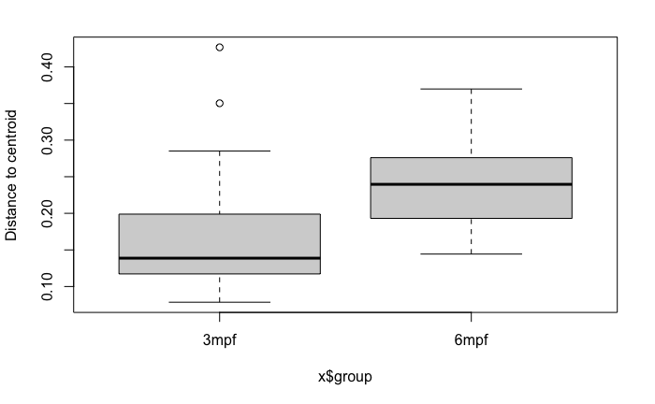
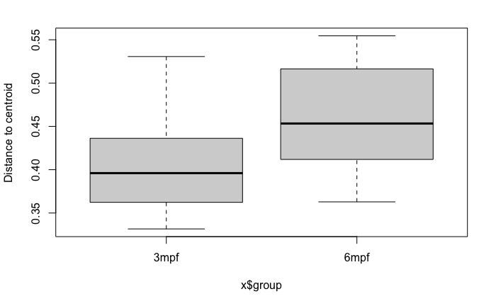
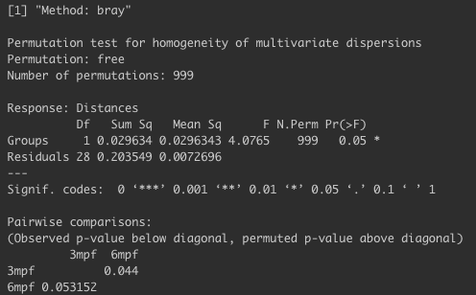
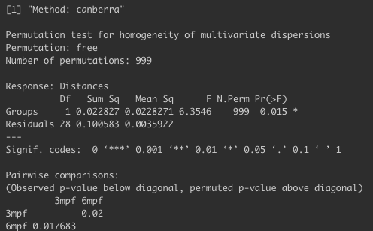

Slide 26
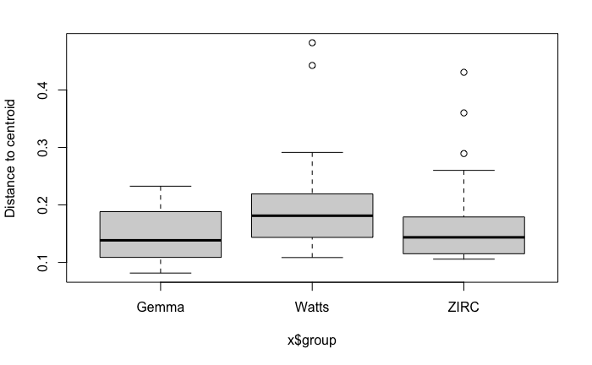
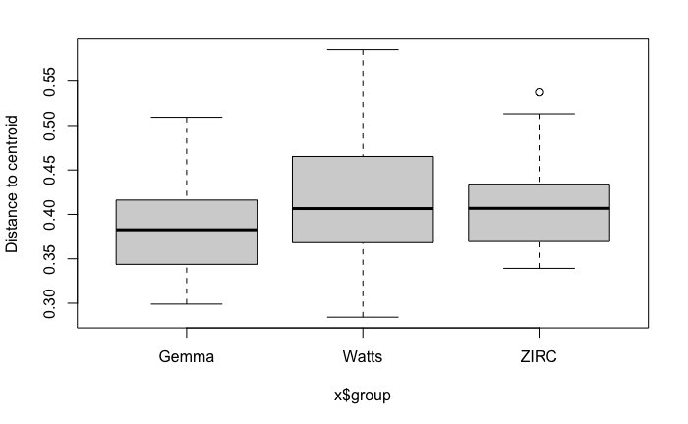
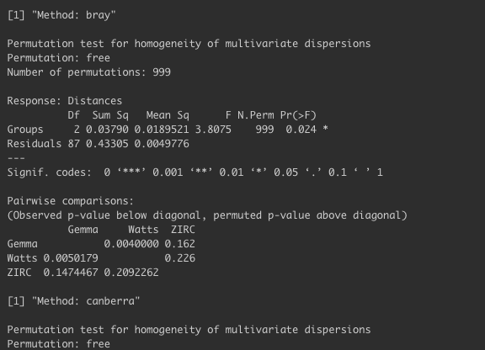
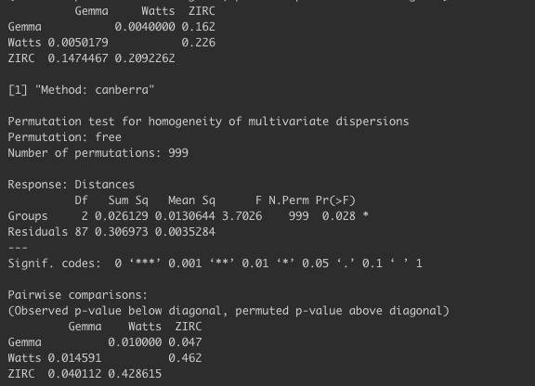
INITIAL

Slide 27
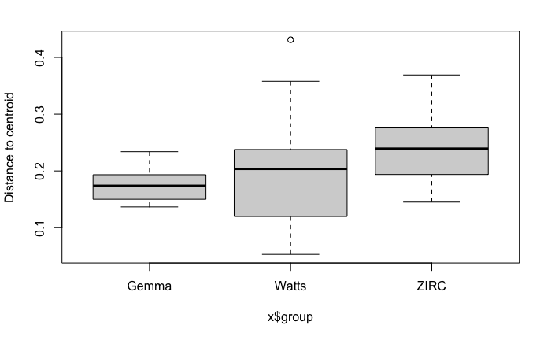
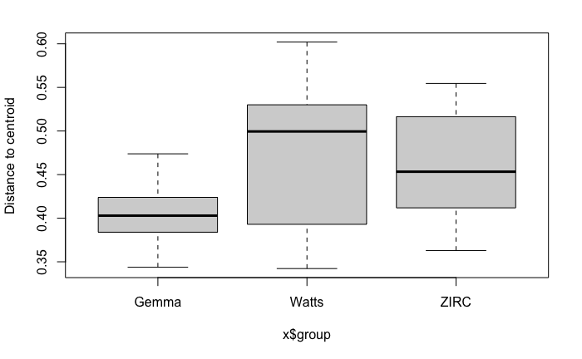
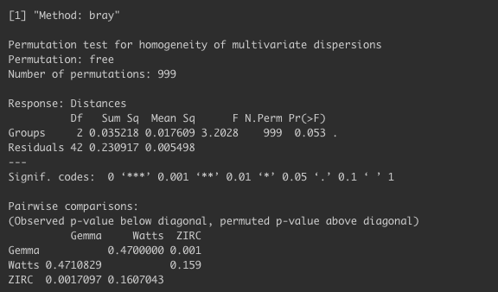
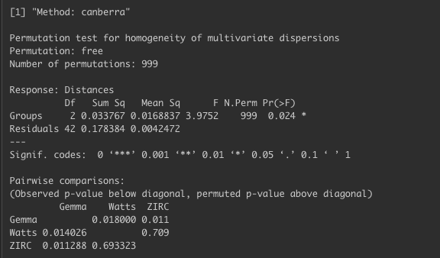
FINAL

Slide 28





Slide 29



Slide 30


Slide 31




Slide 32



Gemma | Watts
ZIRC

Slide 33



Slide 34



Gemma | Watts
ZIRC

Slide 35



Gemma | Watts
ZIRC

Slide 36



Gemma | Watts
ZIRC

Slide 37



Gemma | Watts
ZIRC

Slide 38
Does the composition of the microbiome linked to diet and body condition score/level?

Slide 39


Diet is a stronger predictor of composition than body condition score
(final timepoint)
(final timepoint)

Slide 40


Slide 41
Does microbiome composition stratify by high and low body condition scores?

Slide 42






Gemma
Watts
ZIRC
BCL = 2.25
BCL = 2.25
BCL = 2.25
Gemma
Watts
ZIRC
BCL = 2.25
BCL = 2.25
BCL = 2.25

Slide 43


At 3 mpf the microbiome composition of ZIRC fed fish did not differ, but at 6 mpf they stratified by body condition level
BCL = 2.45
BCL = 2.45

Slide 44


Slide 45

ZIRC fed fish stats

Slide 46
Do certain taxa explain the diversity and compositional differences we see in body condition scores in ZIRC fed fish?

Slide 47
Differentially abundant taxa in ZIRC fed fish by body condition score across both time points

Slide 48
Differentially abundant taxa in ZIRC fed fish by body condition score at final time point

Slide 49
Differentially abundant genera found across body condition levels (2.45) and time in ZIRC fed fish

Slide 50

Aeromonas abundance decreased with body condition score across all diets

Slide 51


Slide 52
How do fish microbiomes develop over time as a function of diet and physiology?

Slide 53



Slide 54



Slide 55



Body Condition Level = 2.25
Body Condition Level = 2.25
Body Condition Level = 2.25

Slide 56


Slide 57


No difference between exposure groups within diets

Slide 58


ZIRC fed fish heaviest across all exposure groups

Slide 61
Does pathogen exposure affect microbiome?

Slide 62


Unexposed fish have higher alpha diversity compared to exposed and pre-exposed fish across all diets

Slide 63



Pathogen exposure stratifies the composition of the gut microbiome

Slide 64



Slide 65


Slide 66
Is the exposure effect on the microbiome diet dependent?

Slide 67



ZIRC is more sensitive to pathogen exposure than other diets

Slide 69



Slide 70


The influence of exposure is secondary to diet
Notes:
What’s interesting here is that exposed and unexposed (aka final timepoint, 6mpf) are overlapping in pretty much all diets. Suggesting a time effect rather than exposure for composition.

Slide 71


Notes:
What’s interesting here is that exposed and unexposed (aka final timepoint, 6mpf) are overlapping in pretty much all diets. Suggesting a time effect rather than exposure for composition.

Slide 72


Slide 73
Differentially abundant genera found across exposure groups

Slide 74
Differentially abundant genera found across exposure groups in ZIRC fed fish

